Slide 1
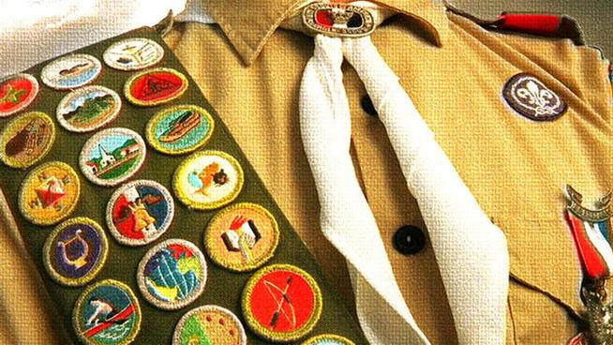
Becoming Persuasive Communicators –
A Guide for Super Troop 197

Slide 2

WHAT IS “PERSUASIVE COMMUNICATION?”
The art of using written or verbal communication
to convince another person
to take an action that you desire or require

Slide 3
IMPORTANT ASPECTS OF PERSUASIVE COMMUNICATION
How well you speak
How well you write
How well you demonstrate
Personal Appearance
Overall Body Language

Slide 4
TEN (10) AUDIENCES THAT YOU WILL NEED TO BE ABLE TO PERSUADE
Troop & Patrol Leadership
Eagle Scout Project Stakeholders
College Admission Oﬃcers
Preparatory School Admission Oﬃcers
Scholarship Administrators
Functional Program Administrators
Study Abroad Program Administrators
College Coaches & Athletic Directors
Corporations
Investors (Banks, Loans, etc.)

Slide 5
FIVE (5) WAYS THE SCOUTING PROGRAM DEVELOPS PERSUASIVE COMMUNICATIONS SKILLS
Obtaining Rank Requirement Signatures
Scoutmaster Conferences
Board of Reviews
Troop & Patrol Leadership Positions
Communications Merit Badge

Slide 6
HOW CAN YOU BECOME A MORE PERSUASIVE COMMUNICATOR?
Meet “MR. SOFT-TALKER”

Slide 7
HOW CAN YOU BECOME A MORE PERSUASIVE COMMUNICATOR?
Meet “MR. EYE-AVOIDER”

Slide 8
HOW CAN YOU BECOME A MORE PERSUASIVE COMMUNICATOR?
Meet “MR. POOR-PLANNER”

Slide 9
HOW CAN YOU BECOME A MORE PERSUASIVE COMMUNICATOR?
Meet “MR. FIDGETTY”

Slide 10
HOW CAN YOU BECOME A MORE PERSUASIVE COMMUNICATOR?
Five (5) Tips for Improving How Well you Speak
Speak-up / Project Your Voice
Slow-down
Use Complete Sentences
Rehearse your Answers
Tell your Personal Stories

Slide 11
HOW CAN YOU BECOME A MORE PERSUASIVE COMMUNICATOR?
Five (5) Tips for Improving How Well you Write
Always open with a greeting & well-wishes
Politely make your specific request
Make your story personal
State your level of enthusiasm about your request
Ask for confirmation & follow-up
*Remember to spell-check before you send

Slide 12
HOW CAN YOU BECOME A MORE PERSUASIVE COMMUNICATOR?
Five (5) Tips for Improving How Well you Demonstrate
Know your audience size
Address the ENTIRE audience
Prepare to “show & tell”
Get creative with visual aids
Consider a “leave-behind”

Slide 13
HOW CAN YOU BECOME A MORE PERSUASIVE COMMUNICATOR?
Five (5) Tips for Improving Your Personal Appearance
Proper Uniform / Attire
Minimize Wrinkles & Scuffs
Meticulous Grooming
Update Rank & Merit Badges
Minimize Symbols of Personal Expression (athletic logos, earrings, tattoos, etc.)

Slide 14
HOW CAN YOU BECOME A MORE PERSUASIVE COMMUNICATOR?
Five (5) Tips for Improving Your Body Language
Always start and end with a firm handshake
Maintain eye-contact
Use your hands to emphasize important points
Lean-forward
Smile, even when listening

Slide 15
HOW CAN YOU BECOME A MORE PERSUASIVE COMMUNICATOR?
Questions?

